Slide 1
Chapter 5 : File Management System in Operating System
What is a file? File:- is a named collection of related information that is recorded on secondary storage. A file is a smallest unit in which the information is stored.
It is a collection of data stored in one unit, identified by a filename witch can be a document, picture, audio or video stream, data library, application, or other collection of data.
File management is one important features of operating system including creating, modifying and deleting the files.
It is the process and act of creating an organized structure in which you store information for easy retrieval.

Slide 2
Cont…
It helps to create new files in computer system and placing them at the specific locations.
It helps in easily and quickly locating these files in computer system and makes sharing of files among different users very easily and user friendly.
It helps to stores the files in separate folders known as directories. These directories help users to search file quickly. All the data on your hard drive consists of files and directories (folders).

Slide 3
Cont…
The basic difference between the two is that files store data, while folders store files and other folders.
The folders, are used to organize files on your computer and themselves take up virtually no space on the hard drive.
Files, on the other hand, can range from a few bytes to several gigabytes.

Slide 4
The file management function is based on the following concepts:
File Attributes
File attributes are most important feature of a file and are information relating to the file, but do not include the data contained within a file.
Specifies the characteristics of the files such as file type, file time stamp (time and date created/modified), size, location on disk etc.
File Operations
It specifies the task that can be performed on a file. Such as opening , Write , Read , Creating file, Updating files, naming file , Renaming file, closing and Deleting.

Slide 5
Cont…
3. File Access permission
It specifies the access permissions related to a file such as, if a user has read permission, but not modify the file or write permissions to modify the file.
4. File Systems
All filesystems need to provide naming and organizational methodology. This defines how a file can be named, specifically the length of a filename and the subset of characters that can be used for filenames out of the total set of characters available.
It also defines the logical structure of the data on a disk, such as the use of directories for organizing files instead of just taking them all together in a single, huge collection of files.
File system is a method of organizing file and data structure that the operating system uses to control how data is stored and retrieved from a storage medium.
It is logical method of file storage in a computer system that manages a disk's internal operations and is abstract to a human user.
Without a file system, stored information wouldn't be isolated into individual files and would be difficult to identify and retrieve.

Slide 6
File systems are different with different operating systems
Unix and Unix-like operating systems
The Unix file system is hierarchical or tree-like structure with its highest level directory called root (denoted by / and pronounced slash).
Below root level directory are several subdirectories like, system files, application files and or user data files.
Similar to the concept of the process parent-child relationship, all files on a Unix system are related to one another. That is, files also have a parent-child existence.
This means, in those systems, there is one root directory, and every file existing on the system is located under it somewhere. Thus, all files (except one) share a common parental link.

Slide 7
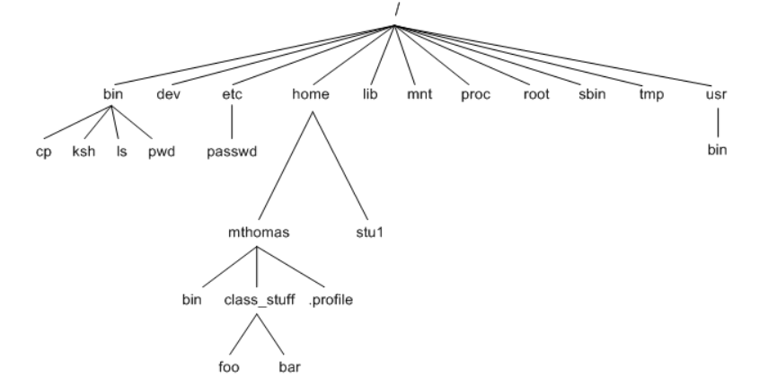
Diagram of Unix file system.

Slide 8
Example of subdirectory
bin is a standard subdirectory of the root directory in Unix-like operating systems that contains the executable (i.e., ready to run) programs, common commands that are used by all the users, like cat, cp, cd, ls, etc.
Home directory is the directory or folder commonly given to a user on a network. With the home directory the user can store all their personal information, files, login scripts, and user information.
/dev: This type of directory consists of files that describe the devices connected to the local system.

Slide 9
Reading assignment about directories present in Unix filesystems:
bin - short for binaries, this is the directory where many commonly used executable commands reside
dev - contains device specific files
etc - contains system configuration files
home - contains user directories and files
lib - contains all library files
mnt - contains device files related to mounted devices
proc - contains files related to system processes
root - the root users' home directory (note this is different than /)
sbin - system binary files reside here. If there is no sbin directory on your system, these files most likely reside in etc
tmp - storage for temporary files which are periodically removed from the filesystem
usr - also contains executable commands

Slide 10
Cont…
All files in the Unix file system can be loosely categorized into 3 types. ordinary files, directory files and device files.
Like a family tree, the tree representing the filesystem is usually pictured upside down, with its root at the top.
The tree "grows" downward from the root, with paths connecting the root to each of the other files. At the end of each path is either an ordinary file or a directory file.
Ordinary files, or simply files, appear at the ends of paths that cannot support other paths and that can hold documents, pictures, programs, and other kinds of data.
Directory files, also referred to as directories or folders, are the points that other paths can branch off from.
Device file or special file is an interface to a device driver that appears in a file system as if it were an ordinary file.

Slide 11
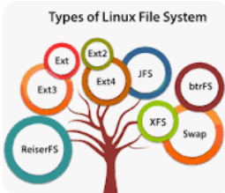
2. Linux File systems
Linux supports many types of filesystems, including some very old ones as well as of the newest.
Each of these filesystem types uses its own metadata structures to define how the data is stored and accessed. Some Types of Linux File System
Ext, Ext2, Ext3 and Ext4 file system. The file system Ext stands for Extended File System and JFS File System stands for Journaled File System.

Slide 12
Example
Ext File System was the first file system designed to support the Linux kernel.
This file system restricted filename lengths to 255 characters.
The Ext2 file system enabled the retention of the internal structure while the file system functionalities extended. Filename lengths were not limited in characters.
So, what about the others ?
Microsoft Windows File systems it make use of the exFAT (FAT12, FAT16, FAT32), NTFS, Live File System and etc.

Slide 13
File Type– Name, Extension
File type refers to the ability of the operating system to distinguish different types of file like document files as text files, source files, binary files , image files like Joint Photographic Experts Group (JPEG), GIF (Graphics Interchange Format) , MP4 (Moving Picture Experts Group and etc.
A common technique for implementing file types is to include the type as part of the file name. The name is split into two parts: a name and an extension.

Slide 14
File Access Methods in Operating System
File access methods in OS are nothing but techniques to read data from the system's memory.
Some systems provide only one access method for files. Other systems, support many access methods, and choosing the right one for a particular application is a major design problem.
There are various ways in which we can access the files from the memory. So, there are three ways to access a file:-
Sequential Access
Direct Access,
Index sequential Method.

Slide 15
Sequential-Access
It is the simplest and most commonly used access method in which, information in the file is accessed in the order it is stored in the file i.e. one record after the other.
The various records cannot be read randomly out of order i.e. we cannot skip any record in between.
If the user wants to read first word of the file then the pointer provides that word to the user and increases its value by 1 word. This process continues till the end of the file.
Modern word systems do provide the concept of direct access and indexed access but the most used method is sequential access due to the fact that most of the files such as text files, audio files, video files, etc. need to be sequentially accessed.
Sequential access is convenient when the storage medium is magnetic tape, rather than disk.

Slide 16
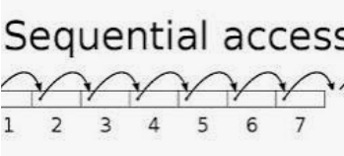
Cont…

Slide 17
Direct Access method
In direct access method it is possible to access the records of a file in any order (i.e. out of order).
For example, if we are reading block 13, we can read block 46 after this and then block 20.The various records can be read or write randomly.
There is no restriction on the order of reading or writing for a direct access file. This way the records can be accessed by key, rather than by position.
This method is also known as relative access method and is typically used in systems implementing disks rather than magnetic tapes.
In direct access method, the various records or blocks of a file are numbered for reference purpose. In order to perform read or write operation, we specify block number where read or write operation is to be performed.
The records need not be in any sequence within the file and they need not be in adjacent locations on the storage medium.

Slide 18
CONT…
The Direct Access is mostly required in the case of database systems in which most of the cases, we need filtered information from the database. The sequential access can be very slow and inefficient in such cases.
For example, database systems of banking application, a customer may want to look up his current balance. This can be done by locating this customer’s record using his account number as a key, rather than sequentially reading the records for thousand of the customers before this customer’s record is located and read.

Slide 19
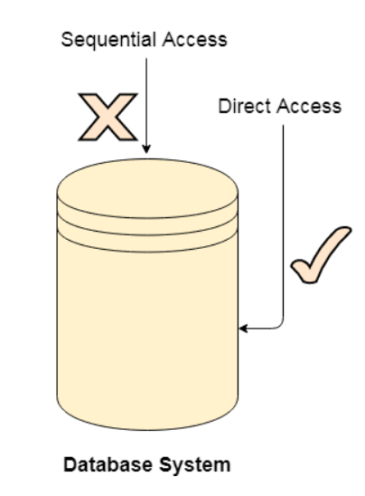
Cont…

Slide 20
Indexed Access
The index is nothing but the address of a record in the file. In this method, an index is created for the file.
This index contains pointer for various blocks of a file, just like an index in the back of a book.
If we want to find a record of a file, first the index is searched and then the pointer f index is used to access that file.
In index accessing, searching in a large database became very quick and easy but we need to have some extra space in the memory to store the index value.
When the size of a file is large, its index itself becomes too large. It requires a lot of storage space because of the presence of index. In such a further an index is created for the index file.

Slide 21
Space Allocation(File Allocation Methods)
The allocation methods define how the files are stored in the disk blocks by operating system.
The main aim is the effective utilization of system storage and faster file access.
There are mainly three types of file allocation techniques:
Continuous File Allocation:
Linked File Allocation:
Indexed File Allocation:

Slide 22
Continuous File Allocation:
In this scheme, each file occupies a contiguous set of blocks on the disk.
For example, if a file requires n blocks and is given a block b as the starting location, then the blocks assigned to the file will be: b, b+1, b+2,……b+n-1.
This means that given the starting block address and the length of the file.
The directory entry for a file with contiguous allocation contains
Address of starting block
Length of the allocated portion.
E.g ,The file ‘mail’ in the following figure starts from the block 19 with length = 6 blocks.
Therefore, it occupies 19, 20, 21, 22, 23, 24 blocks.

Slide 23
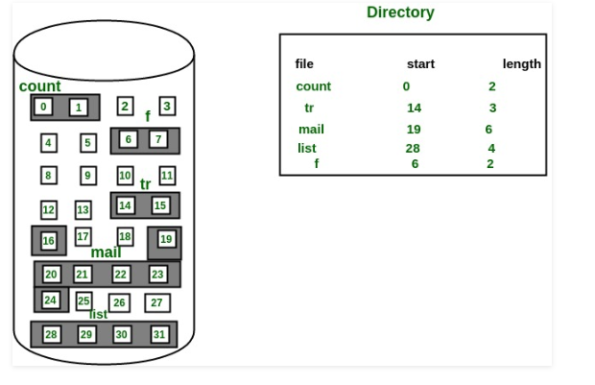
Cont…

Slide 24
Advantages
Both the Sequential and Direct Accesses are supported by this.
For direct access, the address of the kth block of the file which starts at block b can easily be obtained as (b+k).
This is extremely fast since the number of seeks are minimal because of contiguous allocation of file blocks.
Disadvantages:
Increasing file size is difficult because it depends on the availability of contiguous memory at a particular instance.

Slide 25
Linked File Allocation:
Linked File Allocation: Each file is considered to be a linked list of data blocks.
The disk blocks can be scattered anywhere on the disk. Hence files can be scattered anywhere in the memory which need not be contiguous.
The directory entry contains a pointer to the starting and the ending file block.
Each block contains a pointer to the next block occupied by the file.
The file ‘jeep’ in following image shows how the blocks are randomly distributed.
The last block (25) contains -1 indicating a null pointer and does not point to any other block.

Slide 26
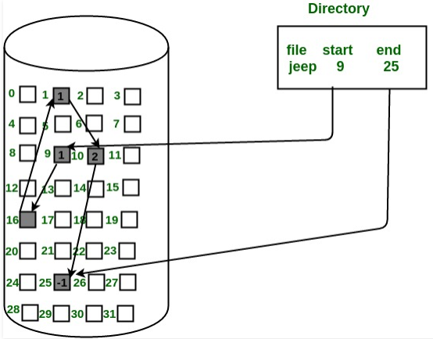
Cont…

Slide 27
Advantages:
This is very flexible in terms of file size. File size can be increased easily since the system does not have to look for a contiguous chunk of memory.
This method does not suffer from external fragmentation. This makes it relatively better in terms of memory utilization.
Disadvantages:
Because the file blocks are distributed randomly on the disk, a large number of seeks are needed to access every block individually. This makes linked allocation slower.
It does not support random or direct access. We can not directly access the blocks of a file.
A block k of a file can be accessed by traversing k blocks sequentially (sequential access ) from the starting block of the file via block pointers.
Pointers required in the linked allocation incur some extra overhead.

Slide 28
Indexed file Allocation
A special block known as index block is used to store pointers. The pointer will point to all the blocks occupied by a file.
In this scheme, a special block known as the Index block contains the pointers to all the blocks occupied by a file.
Each file has its own index block. The ith entry in the index block contains the disk address of the ith file block.
The directory entry contains the address of the index block as shown in the image:

Slide 29
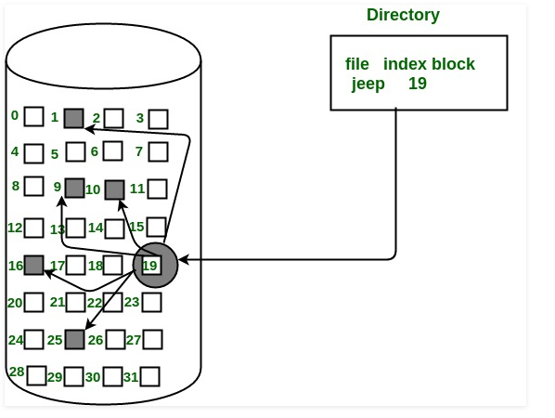
Cont…

Slide 30
Advantages:
This supports direct access to the blocks occupied by the file and therefore provides fast access to the file blocks.
It overcomes the problem of external fragmentation.
Disadvantages:
For very small files, say files that expand only 2-3 blocks, the indexed allocation would keep one entire block (index block) for the pointers which is inefficient in terms of memory utilization.
However, in linked allocation we lose the space of only 1 pointer per block.

Slide 31
The end

